Slide 1








CAPSTONE PROJECT · 2
UNI BRIDGE
A Bridge To Your Dream Universities
AI-Based Study Abroad Recommendation System
AI
ML
LLM
DURVA PALKAR
01 / 06

Slide 2




02 · PROBLEM STATEMENT
Why Students Struggle to Choose?
Country Confusion
Budget Complexity
No Personalization
100+ destinations worldwide — each with unique tuition, culture, visa rules, and rankings
Balancing tuition, living costs, scholarships & currency differences is overwhelming
Generic rankings ignore a student's GPA, test scores, field of study & preferences
Students need intelligent, data-driven, personalized guidance — not just generic rankings.
02 / 06

Slide 3



03 · SOLUTION OVERVIEW
The Intelligent Recommendation Engine
Machine
Learning
LLM /
Gen AI
Data-Driven
Personalized
Explainable AI
Global Coverage
Recommendations
03 / 06

Slide 4





04 · METHODOLOGY
End-to-End AI Pipeline
01
02
03
Real Datasets (Kaggle)
+
Synthetic
Data Creation
Feature
Engineering
Data
Preprocessing
04
05
06
Model Training
& Selection
Custom
Scoring System
AI Integration
(LLM)
Logistic Regression · Random Forest · XGBoost ·
K- Means clustering
Affordability + Preference + Rank
Hugging Face explainer
04 / 06

Slide 5

Prediction + Explanation Pipeline
Student
Profile
ML Model
Prediction
LLM
Explainer
Ranked
Output
System Output Includes:
Universities & Rankings
Tuition & Living Costs
Eligibility & GPA Match
Admission Probability
Powered by Hugging Face — natural language explanations for every recommendation
05 / 06

Slide 6
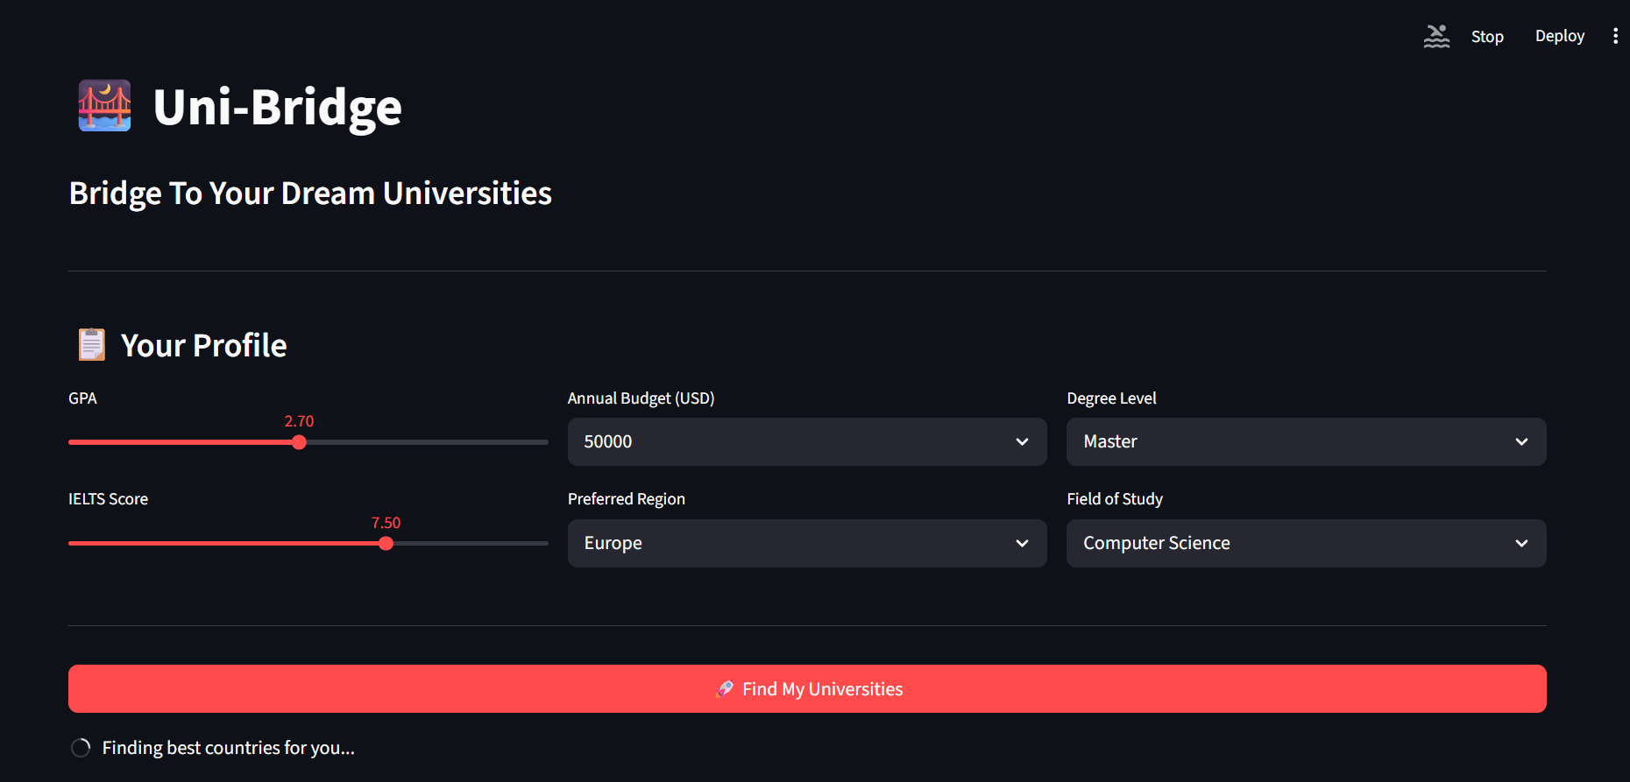
06 ·INTERFACE
05 / 06

Slide 7
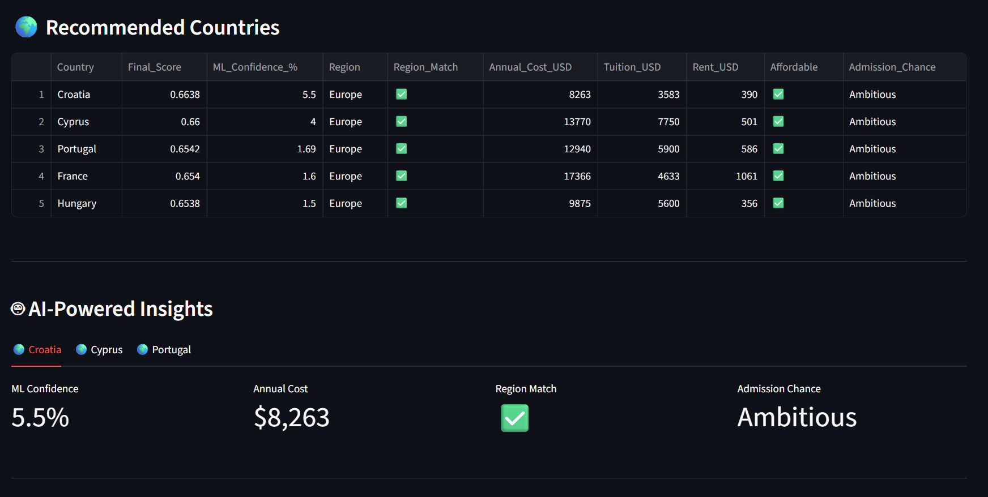
05 / 06

Slide 8
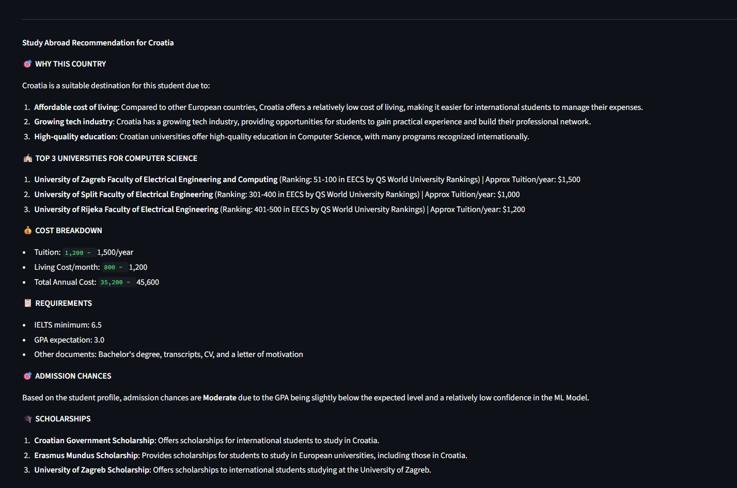
05 / 06

Slide 9


06 · RESULTS & CONCLUSION
Impact & Future Scope
58
100%
Countries Covered
Personalized
Key Results
Future Scope
Affordable & realistic recommendations
Real student data integration as students will rely heavily on AI in future
Personalized per student profile
Visa & SOP preparation assistant
Natural language explanations via LLM
Live scholarship & ranking updates
Research time: weeks → seconds
Mobile app with chatbot interface
06 / 06

